Slide 1
To Buy or Repair?
Comparing the Cost of Buying a New Car to
Repairing My Old One
Anna Deakins
Math 1030 Final Project

Slide 2
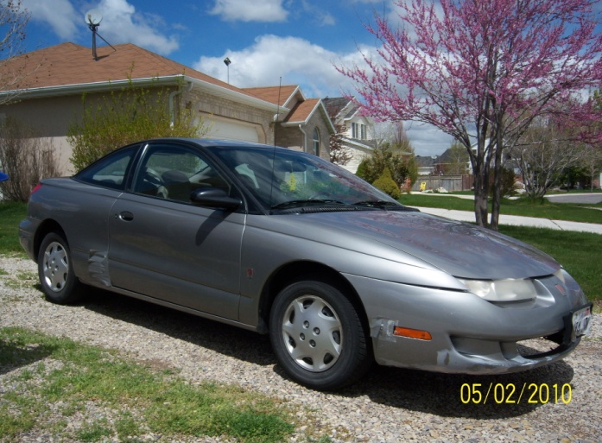
1999 Saturn SC1
145,000 miles
Please note the duct tape used to hold it together

Slide 3
Needed Repairs
Spark plugs $8/plug x 4 plugs = $32
Spark plug wires $17.00
Tires $59.99/tire x 4 tires = $240.00
Replacement wheel rim $65.00 (used)
Alignment $81.00
EGR valve $115.00
Brakes (shoes and rotors/drums) $592.62
Purolator fuel filter $79.99
O2 sensor replacement $61.49
Front and rear shocks and struts $510.72
Power flush on the radiator $80.00
Transmission fluid flush $89.95
Total: $1,964.77

Slide 4
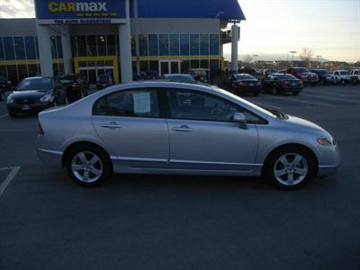
2008 Honda Civic EX 4D Sedan
8,000 miles
25 city/36 highway
Total: $18,599.00

Slide 5
Loans
America First Credit Union
Pmt = P x (APR/n)
1 - (1+APR/n) ^{–nY}
Personal Loan
$2,100
Auto Loan
$19,000
12%, 5 year, fixed
2,100 x (.12/12)
1 – (1 + [.12/12]) ^{-12 x 5}
$46.66/mo
5.49%, 7 year, fixed
19,000 x (.0549/12)
1 – (1 + [.0549/12]) ^{-12 x 7}
$273.35/mo
The auto loan is 5.8 times higher per month

Slide 6
Gas Mileage
(I drive a lot!)
‘99 Saturn
‘08 Honda
19 miles x 1 gallon = 19 miles = $.16
1 mi. $3.00 $3.0 mi.
800 miles x $.16 = (800)(.16)
1 mo. 1 mi. 1 mo.
23 miles x 1 gallon = 23 miles = $.13
1 gallon $3.00 $3.00 mi.
800 miles x $.13 = (800)(.13)
1 mo. mi. 1 mo.
$128 / month
$104 / month
The Honda would be 18% less

Slide 7
Monthly Comprehensive Insurance
Geico Car Insurance
‘99 Saturn
‘08 Honda
$50.00 / month
= $600.00 / year
$78.80 / month
= $945.60 / year
The Honda’s insurance would be 57% more

Slide 8
Sum total of monthly costs
‘99 Saturn
‘08 Honda
Loan: $46.66
Gas: $128.00
Insurance: $50.00
Maintenance: $15.00
Duct Tape: undetermined
Loan: $273.35
Gas: $104.00
Insurance: $78.80
Maintenance: $15.00
$239.66/month
$471.15/month
The monthly cost of the Honda is 49% more than the Saturn

Slide 9
Three Year Comparison
‘99 Saturn
‘08 Honda
Difference
Year 1: $2,875.92
Year 2: $5,751.84
Year 3: $8,627.76
Year 1: $5,653.80
Year 2: $11,307.60
Year 3: $16,961.40
Year 1: $2,777.88
Year 2: $5,555.76
Year 3: $8,333.64
The relative difference over the years remains at 49%

Slide 10
By choosing to repair the Saturn, over three years I could save:
$8,336.64
But, the peace of mind I will get from having a reliable car in good repair is
Priceless

