Slide 1
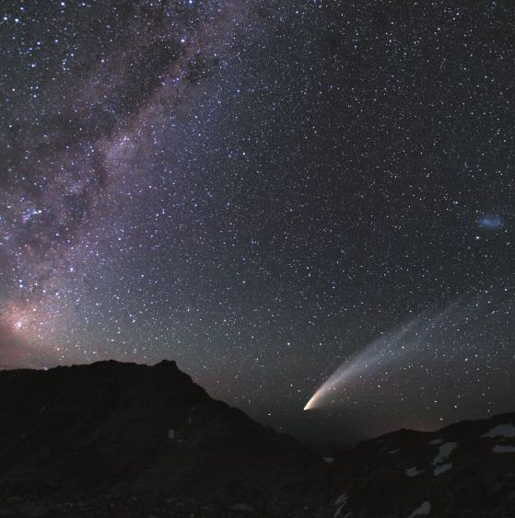
Asteroids & Comets
Exploring Compositions, Origins and Orbits
Anna Deakins
Physics 1040

Slide 2
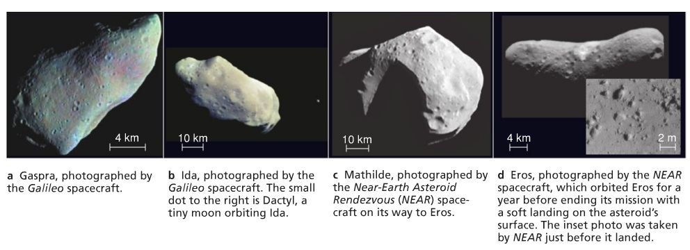
Asteroids
© 2009 Pearson Education, Inc. publishing as Addison-Wesley

Slide 3
What is an Asteroid?
An asteroid is a leftover planetesimal (building block of a planet) that never managed to be incorporated into a planet.
Most are not spherical because they are too small for gravity to effectively reshape them.
The most common asteroids are 1 km. or smaller in size.
There are over 400,000 asteroids that have been recorded.

Slide 4
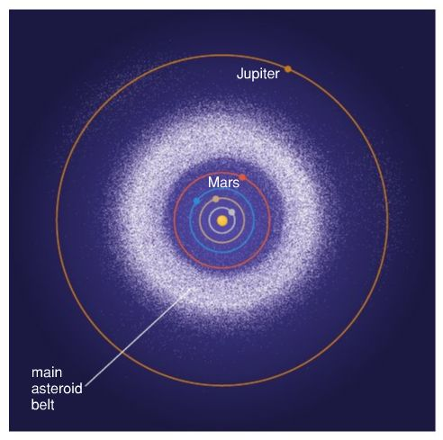
The Asteroid Belt
Asteroids reside in a section of our solar system between the orbits of Mars and Jupiter.
During the development of our solar system, these rocky planetesimals resided equally throughout the space between the Sun and what would become Jupiter.
Most were eventually enveloped into one of the four inner planets: Mercury, Venus, Earth or Mars.
However, the rocky planetesimals that resided between what became Mars and Jupiter survived.
Why were these asteroids able to escape being accreted into a planet?
© 2009 Pearson Education, Inc. publishing as Addison-Wesley

Slide 5
How Jupiter Affects the Asteroid Belt
Jupiter’s gravity is the reason that the planetesimals in The Asteroid Belt did not become a fifth rocky planet.
Orbital Resonance occurs when two astral objects periodically align with each other so that gravity affects them again and again in the same way.
What does this mean for asteroids?
Jupiter has a 12-year orbit and asteroids that have orbits which are fractions of Jupiter’s orbit (6 yrs, 3 yrs, etc.) periodically align with Jupiter and are affected by its gravity.
These asteroids are slowly nudged around in their orbit. Eventually they are nudged enough so that they are ejected out of The Asteroid Belt.
It is the periodic Orbital Resonance from Jupiter which continues to stir up the asteroids and kept them from accreting into a planet.

Slide 6
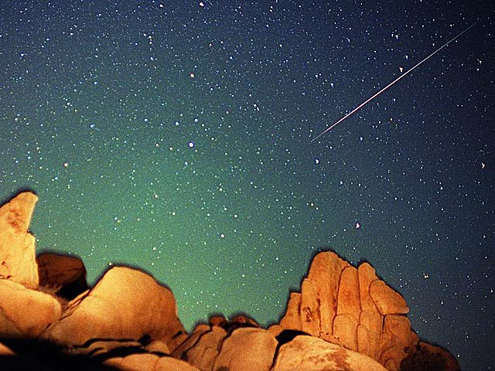
Meteors and Meteorites

Slide 7
What Are Meteors & Meteorites?
A meteor is technically only the flash of light caused by material entering Earth’s atmosphere and burning.
Meteorites are the meteors which were large enough to survive the atmosphere and fall to the ground.
Meteors and meteorites are pieces of asteroids that, after billions of years of orbit in The Asteroids Belt, get ejected and eventually collide with Earth.

Slide 8
The Two Types of Meteorites
Primitive
Processed
A mixture of rock and metal.
Sometimes contain carbon compounds.
Through carbon-dating they are estimated to be 4.6 billion years old, making them virtually unchanged since they formed at the birth of the solar system.
Pieces of large asteroids which were large enough to form core-mantle-crust structures like the terrestrial planets.
Those made of iron came from the shattered cores of asteroids.
Those which are rocky broke from the crust or mantle of the asteroid.

Slide 9
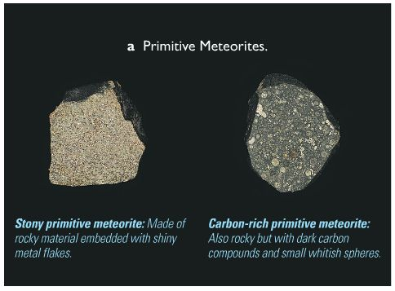
Since Primitive Meteorites are virtually unchanged since forming, they teach us how the first material condensed in the early solar system.
Those made mostly of rocky material formed in area now known as The Asteroid Belt or closer to the Sun (but those asteroids were accreted into planets).
Those made of rock and carbon compounds formed in the outer regions of the solar system, where it was cold enough for carbon compounds to condense.
© 2009 Pearson Education, Inc. publishing as Addison-Wesley

Slide 10
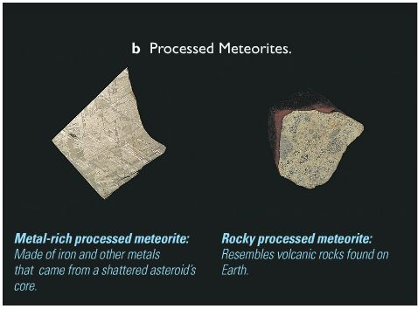
Processed Meteorites tell us what very large asteroids are like inside.
Processed Meteorites are oftentimes so close in composition to lava rock on Earth, scientists conclude that large asteroids had volcanic activity when they were young.
They are proof that young planets did undergo the process of differentiation: the separation of material into core, mantle and crust.
© 2009 Pearson Education, Inc. publishing as Addison-Wesley

Slide 11
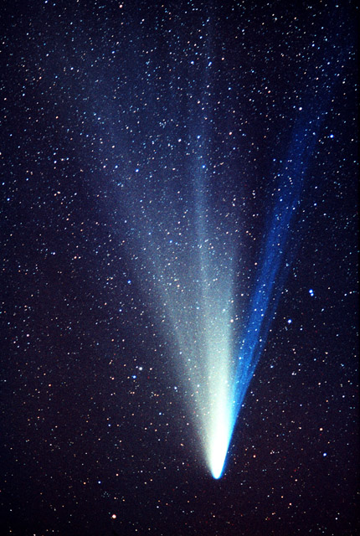
Comets

Slide 12
What is a Comet?
Like asteroids, comets are leftover planetesimals.
Unlike asteroids, comets are rich in ice, since they formed in the distant parts of the solar system.
Comets are distinguished from meteors by their tails and their orbits.
Any icy body that orbits the Sun is referred to as a “comet”, regardless of its size, whether or not it has a tail, or where it formed.

Slide 13
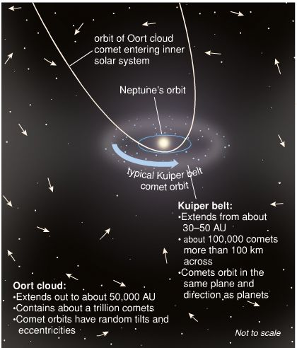
The Kuiper Belt & Oort Cloud
The Kuiper Belt is a second belt of planetesimals, beyond the orbit of Neptune.
Comets in The Kuiper Belt have steady orbits.
Beyond The Kuiper Belt is the Oort Cloud, consisting of about a trillion comets.
These comets’ orbits are highly random.
Most comets that fly by Earth originate from the Oort Cloud.
© 2009 Pearson Education, Inc. publishing as Addison-Wesley

Slide 14
The Tale of Tails
Though it is the tail that make comets famous, most do not have tails. Only comets which have ventured from the Kuiper Belt or Oort Cloud into the inner solar system, heated by the Sun, develop tails.
Far from the Sun, comets are completely frozen. As they plunge into warmer areas of the solar system their ice sublimates into gas.
Some of this gas carries away dust material with it.
The gas and the dust together create an atmosphere around the comet called a “coma”.
The part of the coma that is pushed away from the Sun form the tails of the comet.

Slide 15
Comets have two tails: a plasma tail and a dust tail.
Plasma Tail
Dust Tail
Plasma tails are made of the gas escaping from the comet’s coma.
The sun’s ultraviolet light ionizes this escaped gas.
Solar wind carries this gas directly away from the Sun.
Therefore, the plasma tail always points directly away from the Sun.
Dust tails are made of the dust escaping with gas from the comet’s coma.
Solar wind has no affect on the dust. It is instead carried away from the comet by radiation pressure (pressure exerted by actual photons of light).
The dust tail points somewhat away from the Sun, but is curved due to the trajectory of the comet.

Slide 16
The Tale of Tails, cont’d.
After comets swing around the Sun and begin to head back towards the outer solar system, they gradually loose their tails.
The comet will refreeze and remain that way until its orbit brings it back close enough to the Sun to have its ice sublimate.
After enough times of this happening, comets will have burned enough of their ice to crumble in orbit.

Slide 17
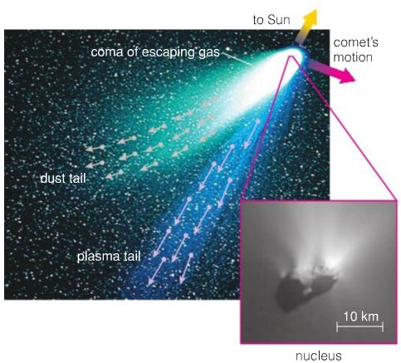
Diagram of a Comet’s Tail
© 2009 Pearson Education, Inc. publishing as Addison-Wesley

Slide 18
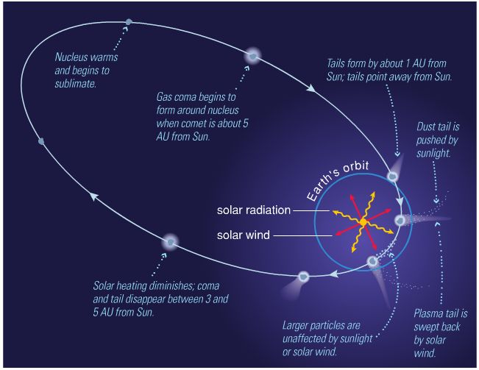
A Comet’s Orbit
© 2009 Pearson Education, Inc. publishing as Addison-Wesley

Slide 19
Asteroids
Rocky planetesimals that never made it into a planet.
They reside between Mars and Jupiter in The Asteroid Belt.
Meteorites
Meteors are only the flash of light in the night sky.
Meteorites are those that make it to the ground.
Comets
Icy planetesimal.
Most do not have tails.
They are asteroids that got ejected from The Asteroid Belt.
Tails form only when a comet comes close enough to the Sun to have its ice sublimated into gas.
The escaping gas carries away dust with it, forming two tails: a plasma tail and a dust tail.

